Slide 1


DESIGN AND DEVELOPMENT OF VOICE CONTROLLED ROBOT FOR MEDICAL APPLICATIONS
THEME: ROBOTICS
By,
SoEC A1-(Batch No-04)
M.Sri Rajeswari Vtu23553
G.Rikitha Vtu23646
K.Mohana Priya Vtu22743
S.Mannya Manoj Vtu21715
B.Umeshwari Vtu23306
Guided by,
MR.T Chitras
A.P/EEE
Dr.Logesh
Associate professor
Mechanical engineering
Vel Tech Rangarajan Dr.Sagunthala R & D Institute of Science & Technology

Slide 2
ABSTRACT
This project was developed in a way that the robot is controlled by voice commands. An Android application with a microcontroller is used for required tasks. The connection between the Android app and the vehicle is facilitated with Bluetooth technology. The robot is controlled by buttons on the application or by spoken commands of the user. The movement of the robot is facilitated by the two dc servo motors connected to the microcontroller at the receiver side. The commands from the application are converted into digital signals by the Bluetooth RF transmitter for an appropriate range (about 100 meters) to the robot. At the receiver end the data gets decoded by the receiver and is fed to the microcontroller which drives the DC motors for the necessary work. The aim of Voice Controlled Robotic Vehicle is to perform the required task by listening to the commands of the user. A prior preparatory session is needed for the smooth operation of the robot by the user. For the same, a code is used for giving instructions to the controller.

Slide 3
LIST OF THEMES
1. AGRICULTURE
2. PUBLIC SAFETY
3. WASTE TO WEALTH
4. ENERGY CONSERVATION
6. ENVIRONMENTAL CONSERVATION
7. ROBOTICS
8. INFRASTRUCTURE
9. TRANSPORTATION
10. BIOENGINEERING
11. RENEWABLE ENERGY

Slide 4
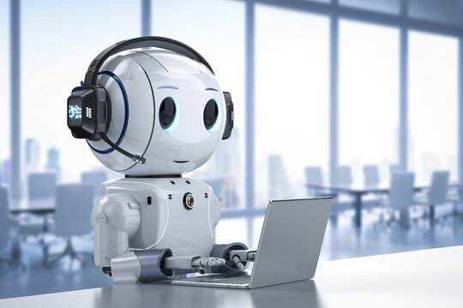

SELECTED THEME: ROBOTICS
Robotics is an interdisciplinary branch of computer science and engineering. Robotics involves the design, construction, operation, and use of robots. The goal of robotics is to design machines that can help and assist humans. Robotics integrates fields of mechanical engineering, electrical engineering, information engineering, bioengineering, computer engineering, control engineering, software engineering, mathematics, etc. Robotics develop machines that can substitute for humans and replicate human actions.

Slide 5
EXISTING METHOD
The Existing system is a speech-recognizing system. Speech recognition is the process of capturing spoken words using a microphone or telephone and converting them into a digitally stored set of words. The quality of a speech recognition system is assessed according to two factors: its accuracy (error rate in converting spoken words to digital data) and speed (how well the software can keep up with a human speaker). Speech recognition technology has endless applications. Commonly, such software is used for automatic translations, dictation, hands-free computing, medical transcription, robotics, automated customer service, and much more. If you have ever paid a bill over the phone using an automated system, you have probably benefited from speech recognition software.

Slide 6
Speech recognition technology has made huge strides within the last decade. However, speech recognition has its weaknesses and nagging problems. Current technology is a long way away from recognizing conversational speech. Despite its shortcomings, speech recognition is quickly growing in popularity. Within the next few years, experts say that speech recognition will be the norm in phone networks the world over. Its spread will be aided by the fact that voice is the only option for controlling automated services in places where touch-tone phones are uncommon

Slide 7
PROBLEM IDENTIFICATION
The problem identification for a voice-controlled robot can be broken down into several aspects:
Voice recognition accuracy: One of the most significant challenges of a voice-controlled robot is achieving accurate voice recognition. The robot must be able to differentiate between different voices, accents, and intonations accurately.
Noise interference: Voice commands are often given in noisy environments. The robot must be able to filter out ambient noise and focus on the user's voice to accurately interpret the command.

Slide 8
3. Limited Vocabulary: Voice-controlled robots can only recognize and respond to a limited set of commands, which can be a problem if the user needs to give complex or specific commands.
4. User Adaptability: Not all users will be comfortable using voice commands, and some may not be able to use them at all due to disabilities or language barriers. The robot must have alternative input methods to accommodate different users.
5. Security and Privacy: Voice-controlled robots may record and store sensitive data, such as personal information or audio recordings of conversations.

Slide 9
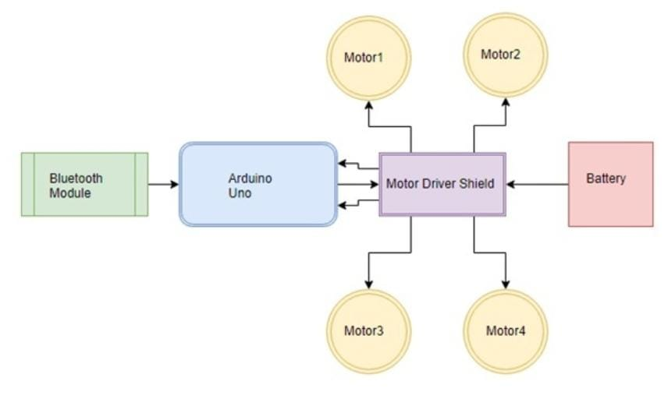
BLOCK DIAGRAM

Slide 10
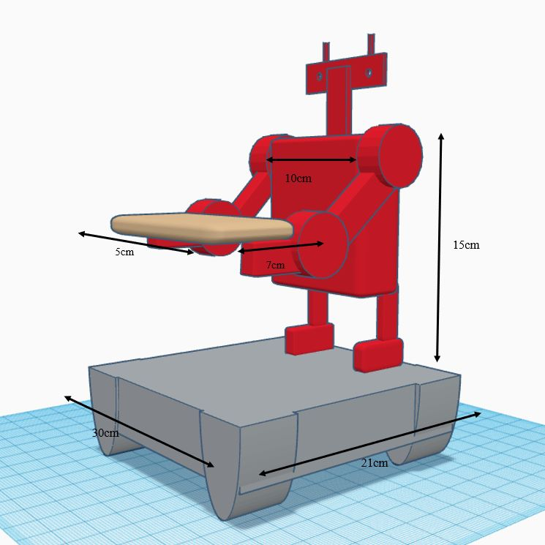
DESIGN

Slide 11
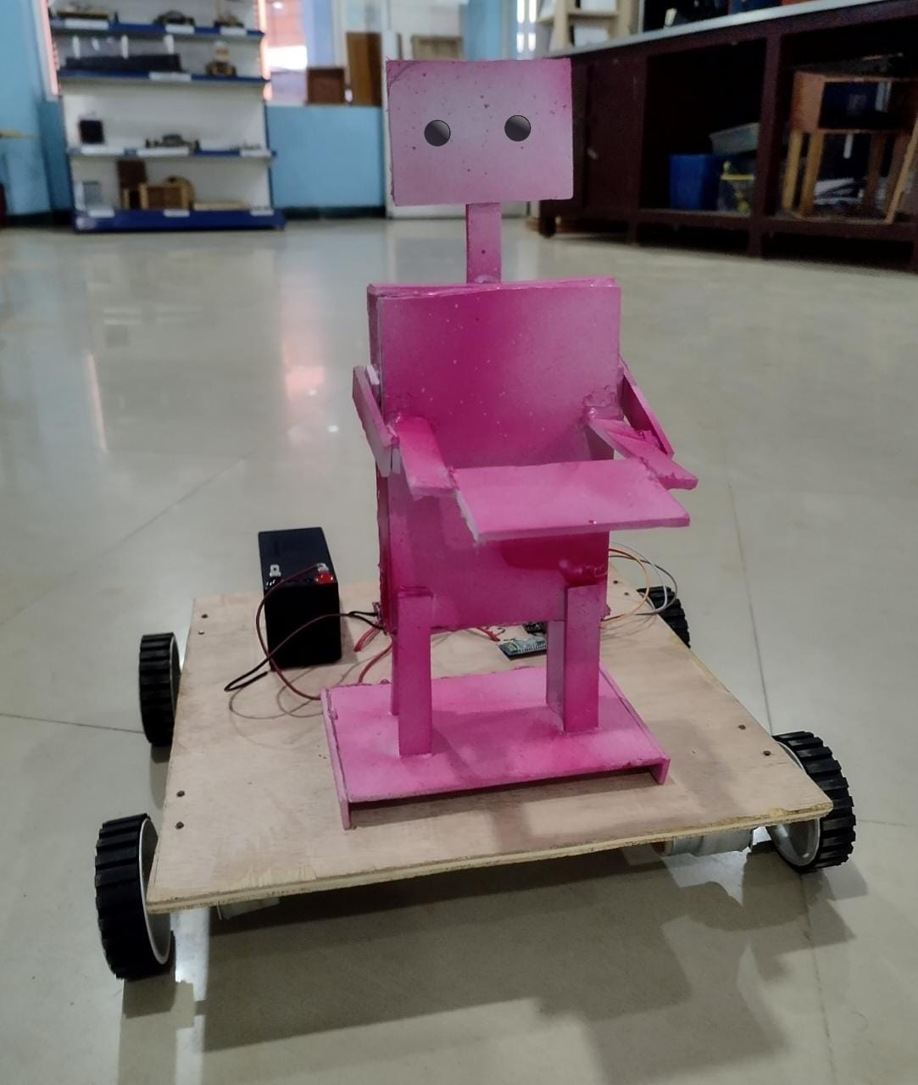
HARDWARE PROTOTYPE

Slide 12
MATERIALS
Aurdino Uno: Microcontroller: ATmega328
Operating Voltage:5V
Input Voltage (recommended): 7-12V
Input Voltage (limits): 6-20V
DC Current per I/O Pin: 20 mA
DC Current for 3.3V Pin: 50 mA
Motor Driver L298: Driver Chip: Double H Bridge L298N
Motor Supply Voltage (Maximum): 46V
Motor Supply Current (Maximum): 2A
Logic Voltage: 5V
Logical Current:0-36mA
Maximum Power (W): 25W
Operating Voltage: 3.3V

Slide 13
Bluetooth HC-05: Bluetooth Version: Bluetooth 2.0+EDR
Operating Voltage: 3.3V
Operating current: <40mA
Sleep current: <1mA
Communication distance: 10 meters
12V BATTERY-1.3Ah: Voltage: 12V (12 Volts)
Capacity: 1.3Ah (1300mAh)
Dimensions: Length 3.82 x Width 1.6
Height 2.05 inches
Weight: 1.2 lb

Slide 14
12v motor with wheels: Operating Voltage: 12V
Rated Speed: 200 RPM
Rated Torque: 1.5 kg-cm
Stall Torque: 5.4 kg-cm
Load Current: 0.3 A
No Load Current: 0.06 A
Jumper wires: Wire Gauge: 22 AWG to 26 AWG
Wire Material: Stranded copper or tinned copper
Insulation Material: PVC or silicone
Length: Typically 3 to 12 inches, but can be longer
or shorter
Sun Board sheet: Thickness: 3mm or 5mm
Color: White
Size: 16" x 12" or A2 (18 Inch X 24 Inch)
Material: Sun Board

Slide 15
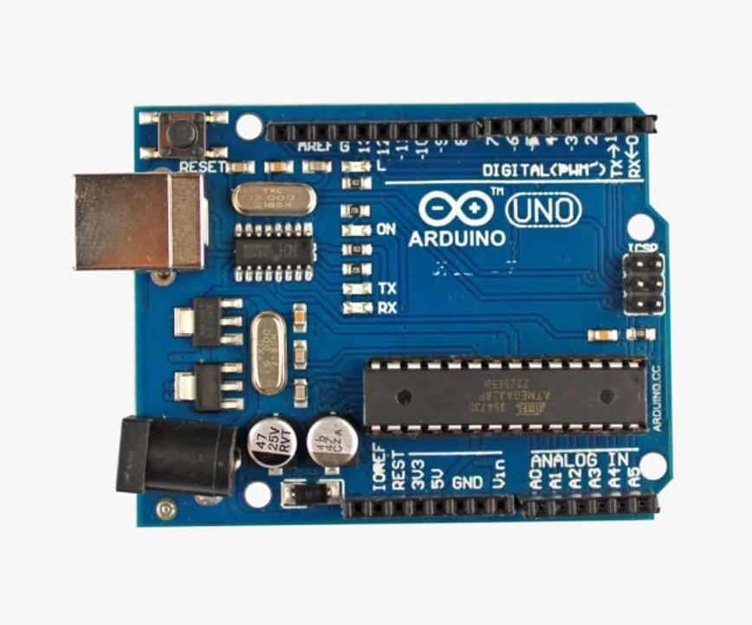
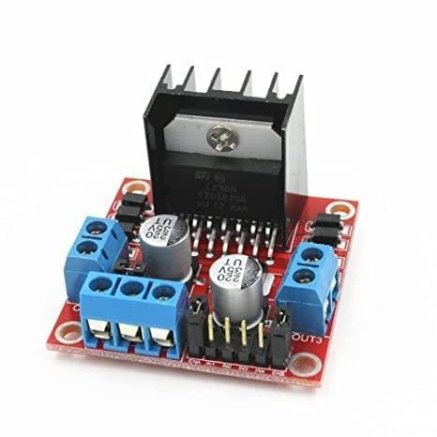
Arduino Uno:
The Arduino Uno is a microcontroller
the board based on the ATmega328P. It has
14 digital input/output pins,
6 analog inputs, a 16 MHz quartz crystal,
A USB connection, a power jack,
an ICSP header and a reset button
Motor Driver L298:
The L298N motor driver module is a high-
power motor driver module for driving
DC and Stepper Motors. It consists of an
L298 motor driver IC and a 78M05 5V
regulator. The L298N module can control
up to 4 DC motors or 2 DC motors with
directional and speed control

Slide 16
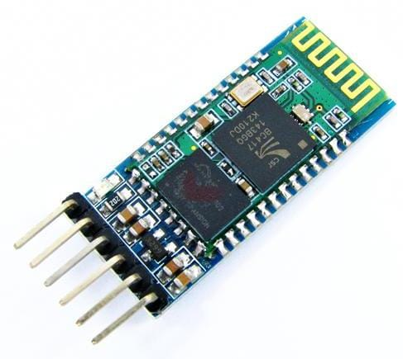
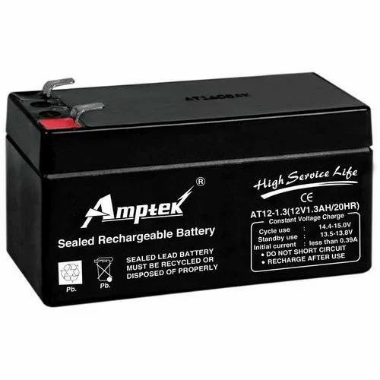
Bluetooth HC-05:
The HC-05 is a Bluetooth module
designed for wireless communication.
It is based on the Bluetooth 2.0 EDR
(Enhanced Data Rate) standard and
can act as either of master or slave
device.
12V BATTERY-1.3Ah:
A 12V battery with a capacity of 1.3Ah is a type of lead-acid battery that is commonly used in various applications such as electronic weighing scales, medical equipment, electronic test equipment, emergency lights and rechargeable fans, communication equipment, school and college robotics projects.

Slide 17
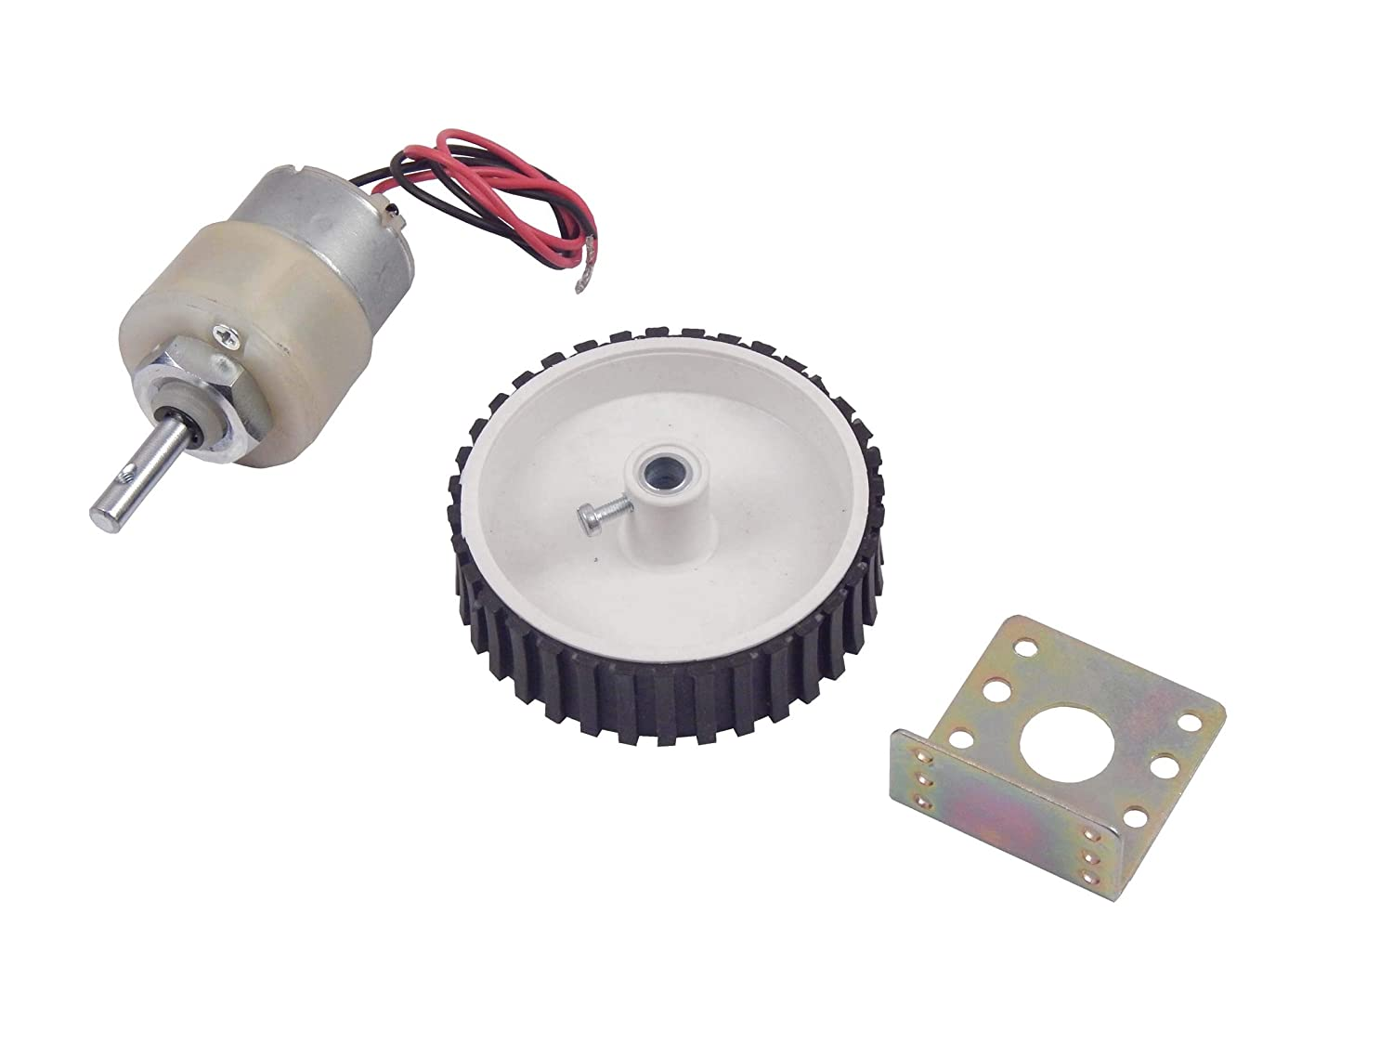
12v motor with wheels & clamps:
12V batteries are used in a variety of applications such as cars, boats, motorcycles, and other vehicles. They are also used in UPS systems, solar panels, and other electronic devices. For example, the Exide 12 Volt/ 7 Ah Powersafe Battery is a sealed battery that is used as an original replacement for UPS batteries. The Rechargeable 12V 7AH Sealed Battery is another example of a 12V battery that is used in various applications such as GPS, CCTV cameras, DVR back up, tablet PC, project work, agricultural and industrial.

Slide 18

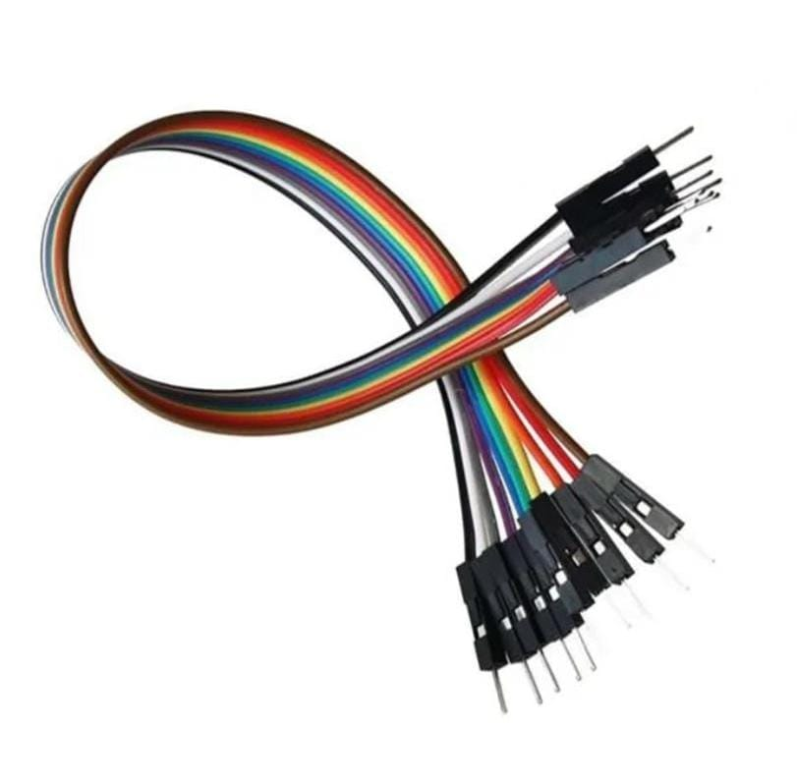
Sun Board sheet:
Sun Board is a very strong, light, and easily cut sheet material used for the mounting of vinyl prints, as backing in framing, and for painting. It usually has three layers — an inner layer of polystyrene foam and a white clay-coated paper on the outside.
Jumper wires:
Jumper wires are electrical wires that are used to connect two points on a breadboard or other prototype or test circuit. They typically come in three versions: male-to-male, male-to-female and female-to-female. You can purchase jumper wires easily and inexpensively or make your own.

Slide 19
SOFTWARE DETAILS
WINDOWS :
Windows is a popular operating system (OS) developed by Microsoft Corporation. It is widely used on desktops, laptops, and servers, and is known for its user-friendly interface, powerful features, and wide range of software applications.
Windows provides a graphical user interface (GUI) that allows users to interact with the OS and applications using icons, menus, and windows. It also supports a wide range of hardware devices, such as printers, scanners, and cameras, and has built-in drivers for many popular devices.

Slide 20
ARDUINO IDE SOFTWARE :
The Arduino Integrated Development Environment (IDE) is a software application used to program Arduino microcontroller boards. It is available for Windows, Mac, and Linux operating systems, and is designed to be user-friendly and easy to use, even for beginners.
The Arduino IDE provides a code editor that supports syntax highlighting and auto-completion, making it easy for users to write and debug Arduino code. It also includes a serial monitor that allows users to send and receive data from their Arduino board, as well as a built-in library manager that makes it easy to download and install libraries for common tasks.

Slide 21
ANDROID PHONE :
An Android phone is a type of smartphone that uses the Android operating system (OS) developed by Google. Android is one of the most popular mobile operating systems in the world and is used on a wide range of smartphones, tablets, and other mobile devices.
Android phones come in various sizes, shapes, and configurations, with different features and capabilities. Most Android phones have touchscreens, cameras, and support for Wi-Fi and cellular connectivity, as well as GPS and Bluetooth capabilities. They can also run a wide range of apps, from social media and productivity apps to games and entertainment apps.

Slide 22
BLUETOOTH CONTROLLER APP :
A Bluetooth controller app is a software application that allows users to connect and control devices that use Bluetooth technology. These apps are commonly used with gaming controllers, speakers, headphones, and other Bluetooth-enabled devices.
The app typically connects to the device via Bluetooth and provides a user interface for controlling various functions of the device. For example, a Bluetooth controller app for a gaming controller might allow users to customize button mapping, adjust vibration settings, or change other settings related to gameplay. Similarly, a Bluetooth controller app for speakers or headphones might allow users to adjust the volume, equalizer settings, or other audio parameters.

Slide 23
CODE :
#include <SoftwareSerial.h>
SoftwareSerial BT(0, 1); //TX, RX respectively
String readvoice;
void setup() {
BT.begin(9600);
Serial.begin(9600);
pinMode(4, OUTPUT);
pinMode(3, OUTPUT);
pinMode(5, OUTPUT);
pinMode(6, OUTPUT);
}
void loop() {
while (BT.available()){ //Check if there is an available byte to read
delay(10); //Delay added to make thing stable
char c = BT.read(); //Conduct a serial read
readvoice += c; //build the string- "forward", "reverse", "left" and "right"
}
if (readvoice.length() > 0) {
Serial.println(readvoice);
if(readvoice == "* backf#")

Slide 24
{
digitalWrite(3, HIGH);
digitalWrite (4, HIGH);
digitalWrite(5,LOW);
digitalWrite(6,LOW);
delay(100);
}
else if(readvoice == "* forward#")
{
digitalWrite(3, LOW);
digitalWrite(4, LOW);
digitalWrite(5, HIGH);
digitalWrite(6,HIGH);
delay(100);
}
else if (readvoice == "*left#")
{
digitalWrite (3, HIGH);
digitalWrite (4, LOW);
digitalWrite (5, LOW);
digitalWrite (6, LOW);

Slide 25
delay (800);
digitalWrite(3, HIGH);
digitalWrite (4, HIGH);
digitalWrite(5,LOW);
digitalWrite(6,LOW);
delay(100);
}
else if ( readvoice == "*right#")
{
digitalWrite (3, LOW);
digitalWrite (4, HIGH);
digitalWrite (5, LOW);
digitalWrite (6, LOW);
delay (800);
digitalWrite(3, HIGH);
digitalWrite (4, HIGH);
digitalWrite(5,LOW);
digitalWrite(6,LOW);
delay(100);
}
else if (readvoice == "*show me Garba#")

Slide 26
digitalWrite (3, LOW);
digitalWrite (4, HIGH);
digitalWrite (5, LOW);
digitalWrite (6, LOW);
delay (400);
digitalWrite(3, HIGH);
digitalWrite (4, HIGH);
digitalWrite(5,LOW);
digitalWrite(6,LOW);
delay(600);
digitalWrite (3, LOW);
digitalWrite (4, HIGH);
digitalWrite (5, HIGH);
digitalWrite (6, LOW);
delay (500);
digitalWrite (3, HIGH);
digitalWrite (4, LOW);
digitalWrite (5, LOW);
digitalWrite (6, HIGH);
delay (500);

Slide 27
digitalWrite (3, LOW);
digitalWrite (4, HIGH);
digitalWrite (5, LOW);
digitalWrite (6, LOW);
delay (400);
digitalWrite(3, HIGH);
digitalWrite (4, HIGH);
digitalWrite(5,LOW);
digitalWrite(6,LOW);
delay(600);
digitalWrite (3, LOW);
digitalWrite (4, HIGH);
digitalWrite (5, HIGH);
digitalWrite (6, LOW);
delay (500);
digitalWrite (3, HIGH);
digitalWrite (4, LOW);
digitalWrite (5, LOW);
digitalWrite (6, HIGH);

Slide 28
delay (500);digitalWrite (3, LOW);
digitalWrite (4, HIGH);
digitalWrite (5, LOW);
digitalWrite (6, LOW);
delay (400);
digitalWrite(3, HIGH);
digitalWrite (4, HIGH);
digitalWrite(5,LOW);
digitalWrite(6,LOW);
delay(600);
digitalWrite (3, LOW);
digitalWrite (4, HIGH);
digitalWrite (5, HIGH);
digitalWrite (6, LOW);
delay (500);
digitalWrite (3, HIGH);
digitalWrite (4, LOW);
digitalWrite (5, LOW);
digitalWrite (6, HIGH);
delay (500);digitalWrite (3, LOW);

Slide 29
digitalWrite (4, HIGH);
digitalWrite (5, LOW);
digitalWrite (6, LOW);
delay (400);
digitalWrite(3, HIGH);
digitalWrite (4, HIGH);
digitalWrite(5,LOW);
digitalWrite(6,LOW);
delay(600);
digitalWrite (3, LOW);
digitalWrite (4, HIGH);
digitalWrite (5, HIGH);
digitalWrite (6, LOW);
delay (500);
digitalWrite (3, HIGH);
digitalWrite (4, LOW);
digitalWrite (5, LOW);
digitalWrite (6, HIGH);
delay (500);digitalWrite (3, LOW);
digitalWrite (4, HIGH);
digitalWrite (5, LOW);
digitalWrite (6, LOW);

Slide 30
delay (400);
digitalWrite(3, HIGH);
digitalWrite (4, HIGH);
digitalWrite(5,LOW);
digitalWrite(6,LOW);
delay(600);
digitalWrite (3, LOW);
digitalWrite (4, HIGH);
digitalWrite (5, HIGH);
digitalWrite (6, LOW);
delay (500);
digitalWrite (3, HIGH);
digitalWrite (4, LOW);
digitalWrite (5, LOW);
digitalWrite (6, HIGH);
delay (500);digitalWrite (3, LOW);
digitalWrite (4, HIGH);
digitalWrite (5, LOW);
digitalWrite (6, LOW);
delay (400);

Slide 31
digitalWrite(3, HIGH);
digitalWrite (4, HIGH);
digitalWrite(5,LOW);
digitalWrite(6,LOW);
delay(600);
digitalWrite (3, LOW);
digitalWrite (4, HIGH);
digitalWrite (5, HIGH);
digitalWrite (6, LOW);
delay (500);
digitalWrite (3, HIGH);
digitalWrite (4, LOW);
digitalWrite (5, LOW);
digitalWrite (6, HIGH);
delay (500);digitalWrite (3, LOW);
digitalWrite (4, HIGH);
digitalWrite (5, LOW);
digitalWrite (6, LOW);
delay (400);

Slide 32
digitalWrite(3, HIGH);
digitalWrite (4, HIGH);
digitalWrite(5,LOW);
digitalWrite(6,LOW);
delay(600);
digitalWrite (3, LOW);
digitalWrite (4, HIGH);
digitalWrite (5, HIGH);
digitalWrite (6, LOW);
delay (500);
digitalWrite (3, HIGH);
digitalWrite (4, LOW);
digitalWrite (5, LOW);
digitalWrite (6, HIGH);
delay (500);digitalWrite (3, LOW);
digitalWrite (4, HIGH);
digitalWrite (5, LOW);
digitalWrite (6, LOW);
delay (400);

Slide 33
digitalWrite(3, HIGH);
digitalWrite (4, HIGH);
digitalWrite(5,LOW);
digitalWrite(6,LOW);
delay(600);
digitalWrite (3, LOW);
digitalWrite (4, HIGH);
digitalWrite (5, HIGH);
digitalWrite (6, LOW);
delay (500);
digitalWrite (3, HIGH);
digitalWrite (4, LOW);
digitalWrite (5, LOW);
digitalWrite (6, HIGH);
delay (500);
}
readvoice="";}} //Reset the variable

Slide 34
WORKING PRINCIPLE
The working principle of a voice-controlled robot involves the following steps:
1. Voice-controlled robot helps to control the robot through voice commands received via an Android application.
2. The user gives a voice command to the robot.
3. The robot’s microphone captures the sound waves and converts them into
electrical signals.

Slide 35
4. The electrical signals are then processed by the robot’s microcontroller.
5. The microcontroller analyzes the signals and identifies the command given by
the user.
6. The robot then performs the specified operation based on the command given.

Slide 36
ADVANTAGES:
Voice commands are a far more efficient tool than typing messages.
Time-saving, easy to use.
It is hands-free, which means that you can control it without having to use your hands.
The proposed robot is capable of understanding the meaning of natural language commands.
DISADVANTAGES:
They can be less accurate than other types of robots.
voice-recognization software is not perfect and can sometimes misinterpret what you say.
Background noise interference.

Slide 37
CONCLUSION
The proposed structure of our work shows how a robot can be controlled using Bluetooth. The voice is sent through the Bluetooth innovation and the ideal working actually occurs. This assignment reduces human undertakings at spots or conditions where human interventions are inconvenient. Such systems can be brought into usage at spots, for model, business organizations, home automation, military and gatekeeper, investigation purposes, etc.
Future scope:
Here we have used a Bluetooth module that has a limitation of range. In the future, we can add a WIFI module to it for preventing the range limitation.
Internet of Things – This will permit the client to control the vehicle from any place in the world.

Slide 38
REFERENCE
S.NO | TITLE | PUBLICATION | AUTHOR | YEAR
1 | An AI-based Voice Controlled Humanoid Robot. |  | Naeem, B. and Yousuf, N., | 2023
2 | Service robot using voice recognition. | In AIP Conference Proceedings (Vol. 2643, No. 1, p. 050061). AIP Publishing LLC. | Rashid, M.M., Ali, M.Y. and Sailan, S., | 2023
3 | Gesture and Voice Controlled Robot for Industrial Applications. | Published in: 2022 International Conference for Advancement in Technology (ICONAT) Publisher: IEEE | Vanamala, H.R., Akash, S.M., Vinay, A., Kumar, S. | 2022

Slide 39
LIST OF MODELS:
Carpentry :
Wooden window
Sliding door
Wheel chair
Crank and slotted link
Electronics :
Power supply board
Emergency light
Relay Board
Machine Shop :
Machine Vice
Bolt and nut assembly
Simple and compound Gear train
Sheet metal tray

Slide 40
SELECTED MODELS
CARPENTARY : WOODEN WINDOW
ELECTRONICS : EMERGENCY LIGHT
MACHINE SHOP : SHEET METAL TRAY

Slide 41
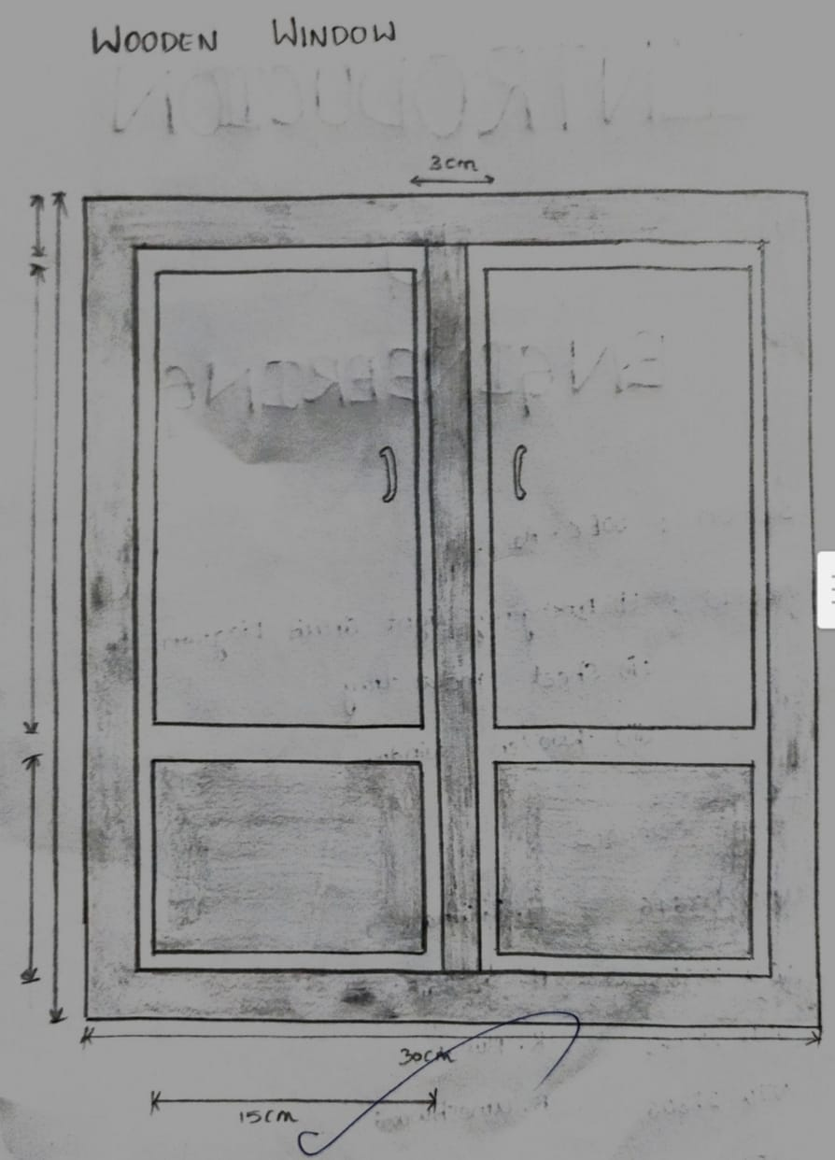
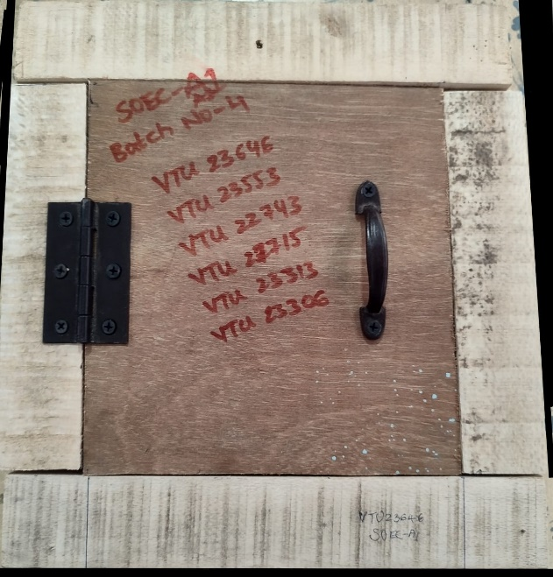
MODEL 1: WOODEN WINDOW
TOOLS USED:
1. Wooden cutting machine
2. Drilling machine
MATERIALS REQUIRED:
1. Wood
2. Chisel
3. Nails
4. Glue
SKILLS LEARNED:
1. Teamwork
2. How to cut the wood
3. Accurate measuring
4. Learned how to use tools

Slide 42
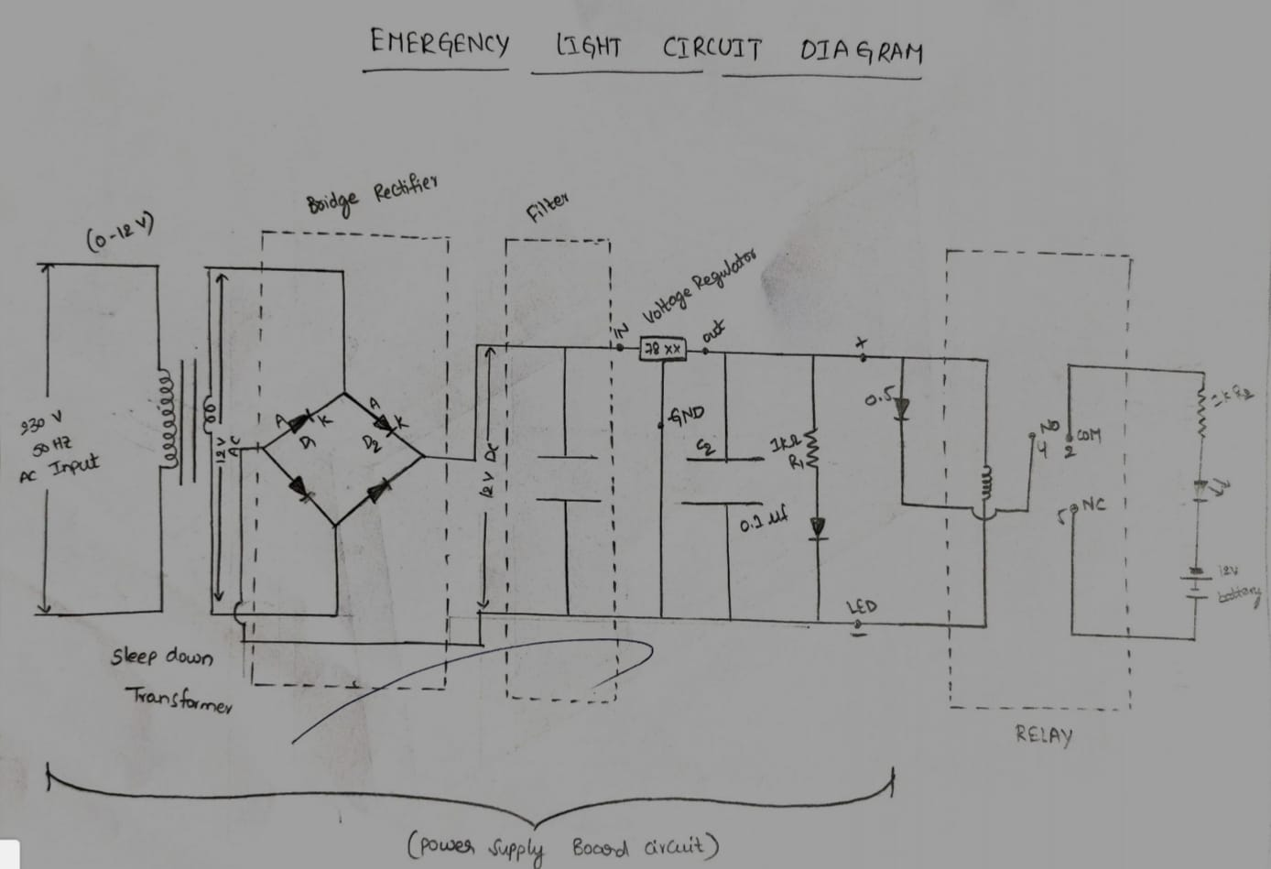
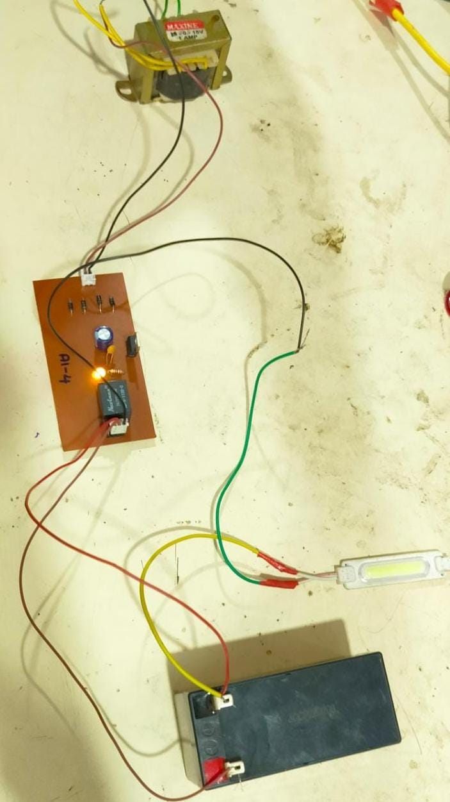
MODEL 2 : EMERGENCY LIGHT
TOOLS USED:
1. Single side copper clad
2. Digital multiplier
3.Drilling machine
4.Soldering
MATERIALS REQUIRED:
1.LED’S
2.Diodes
3.Capacitors
4.Transformers
SKILLS LEARNED:
1.Soldering
2.Drilling
3.Wire connections
4.Arranging the circuit elements

Slide 43
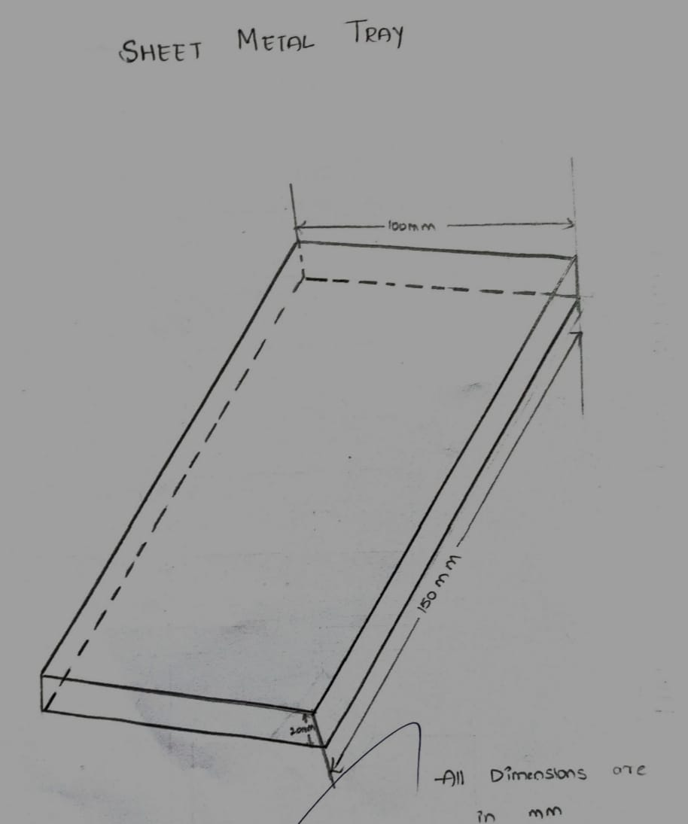
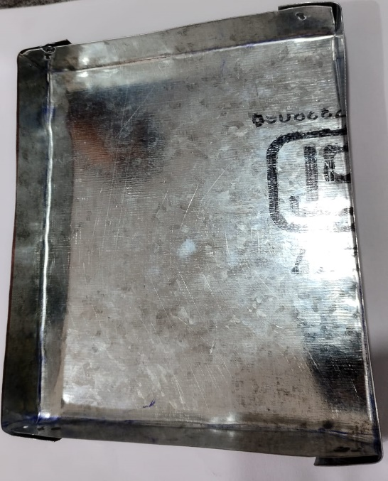
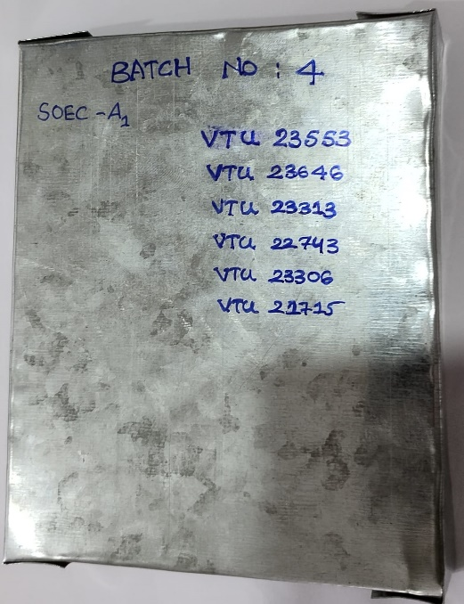
MODEL 3 : SHEET METAL TRAY
TOOLS USED:
1.Hammer
2.Power drill
3.Ruler
MATERIALS REQUIRED:
1.Pap rivets
2.Sheet metal
3.Tape measure
SKILLS LEARNED:
1.Team work
2. Accurate measuring
3. Learned how to use tools

Slide 44
Thank YOU

